Slide 1

APEX INSTITUTE OF TECHNOLOGY
DEPARTMENT OF COMPUTER SCIENCE & ENGINEERING
Artificial Intelligence (20CSD-385)
Faculty: Ankur Sharma(E13693)
Lecture – 1.3
Informed search
DISCOVER . LEARN . EMPOWER

Slide 2
Artificial Intelligence : Course Objectives
COURSE OBJECTIVES
(AI) is a research field that studies how to realize the intelligent human behaviors on a computer. The ultimate goal of AI is to make a computer that can learn, plan, and solve problems autonomously. Although AI has been studied for more than half a century, we still cannot make a computer that is as intelligent as a human in all aspects, The main research topics in AI include: problem solving, reasoning, planning, natural language understanding, computer vision, automatic programming, machine learning, and so on. Of course, these topics are closely related with each other. In this course, we will study the most fundamental knowledge for understanding AI. We will introduce some basic search algorithms for problem solving; knowledge representation and reasoning; pattern recognition; fuzzy logic; and neural networks

Slide 3
COURSE OUTCOMES
On completion of this course, the students shall be able to:-
CO1 | Understand the basics of the theory and practice of Artificial Intelligence as a discipline and about intelligent agents capable of problem formulation
CO2 | Apply different uninformed search algorithms on well formulate problems along with stating valid conclusions that the evaluation supports.

Slide 4
Unit-1 Syllabus
Unit-1
Ch1.Introduction to AI | Introduction Artificial Intelligence and its applications, Artificial Intelligence Techniques, Intelligent Agents, Nature of Agents, Learning Agents., advantages, and limitations of AI, Application of AI.
Ch2.Searching techniques | Problem solving techniques State space search, control strategies, Blind search
Ch3.Informed search | Heuristic search, problem characteristics, production system characteristics., Generate and test, Hill climbing, best first search, A* search, Constraint satisfaction problem.

Slide 5
SUGGESTIVE READINGS
TEXT BOOKS
T1. Artificial Intelligence: A Modern Approach by Stuart Russell and Peter Norvig. Prentice-Hall, 2003 (2ndEdition). T2. Elaine Riche, Kevin Knight and Shivashankar B. Nair, “Artificial Intelligence”, Third Edition, TMH Educations Pvt. Ltd., 2008
REFERENCE BOOKS
R1 Nils J. Nilsson, “The Quest for Artificial Intelligence”, Second Edition, Cambridge University Press, 2009
R2 Artificial Intelligence and Expert Systems – Dan W. Patterson, Prentice Hall of India

Slide 6
Informed search
An informed search is more efficient than an uninformed search because in informed search, along with the current state information, some additional information is also present, which make it easy to reach the goal state.

Slide 7
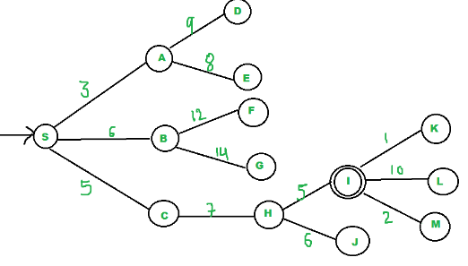
Best-first Search
We start from source “S” and search for goal “I” using given costs and Best First search.
pq initially contains S
We remove S from pq and process unvisited neighbors of S to pq.
pq now contains {A, C, B} (C is put before B because C has lesser cost)
We remove A from pq and process unvisited neighbors of A to pq.
pq now contains {C, B, E, D}
We remove C from pq and process unvisited neighbors of C to pq.
pq now contains {B, H, E, D}
We remove B from pq and process unvisited neighbors of B to pq.
pq now contains {H, E, D, F, G}
We remove H from pq.
Since our goal “I” is a neighbor of H, we return.
Best-first search is known as a greedy search because it always tries to explore the node which is nearest to the goal node and selects that path, which gives a quick solution. Thus, it evaluates nodes with the help of the heuristic function, i.e., f(n)=h(n).

Slide 8
The performance measure of Best-first search Algorithm:
Completeness: Best-first search is incomplete even in finite state space.
Optimality: It does not provide an optimal solution.
Time and Space complexity: It has O(bm) worst time and space complexity, where m is the maximum depth of the search tree. If the quality of the heuristic function is good, the complexities could be reduced substantially.
Note: Best first searches combines the advantage of BFS and DFS to find the best solution.
Disadvantages of Best-first search
BFS does not guarantees to reach the goal state.
Since the best-first search is a greedy approach, it does not give an optimized solution.
It may cover a long distance in some cases.

Slide 9
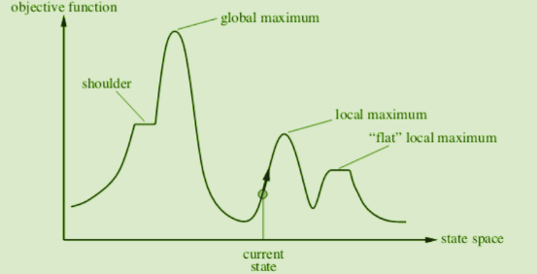
Hill Climbing

Slide 10
Hill Climbing
It is a variant of the generate-and-test algorithm It makes use of the greedy approach This means it keeps generating possible solutions until it finds the expected solution, and moves only in the direction which optimizes the cost function for it.
Types of Hill Climbing in AI
Simple Hill Climbing- This examines one neighboring node at a time and selects the first one that optimizes the current cost to be the next node.
Steepest Ascent Hill Climbing This examines all neighboring nodes and selects the one closest to the solution state.
Stochastic Hill Climbing- This selects a neighboring node at random and decides whether to move to it or examine another.

Slide 11
Problems in different regions in Hill climbing
Problems in different regions in Hill climbing
Hill climbing cannot reach the optimal/best state(global maximum) if it enters any of the following regions :
Local maximum: At a local maximum all neighboring states have a value that is worse than the current state. Since hill-climbing uses a greedy approach, it will not move to the worse state and terminate itself. The process will end even though a better solution may exist. To overcome the local maximum problem: Utilize the backtracking technique. Maintain a list of visited states. If the search reaches an undesirable state, it can backtrack to the previous configuration and explore a new path.
Plateau: On the plateau, all neighbors have the same value. Hence, it is not possible to select thebest direction. To overcome plateaus: Make a big jump. Randomly select a state far away from the current state. Chances are that we will land in a non-plateau region.
Ridge: Any point on a ridge can look like a peak because movement in all possible directions is downward. Hence the algorithm stops when it reaches this state. To overcome Ridge: In this kind of obstacle, use two or more rules before testing. It implies moving in several directions at once.

Slide 12
Algorithm for simple hill climbing.
Evaluate initial state- if goal state, stop and return success. Else, make initial state current.
Loop until the solution reached or until no new operators left to apply to current state:
a. Select new operator to apply to the current producing new state.
b. Evaluate new state:
If a goal state, stop and return success.
If better than the current state, make it current state, proceed.
Even if not better than the current state, continue until the solution reached.
Exit.

Slide 13
A* Search Algorithm
A* search is the most widely used informed search algorithm where a node n is evaluated by combining values of the functions g(n)and h(n). The function g(n) is the path cost from the start/initial node to a node n and h(n) is the estimated cost of the cheapest path from node n to the goal node. Therefore, we have
f(n)=g(n)+h(n)
where f(n) is the estimated cost of the cheapest solution through n.

Slide 14
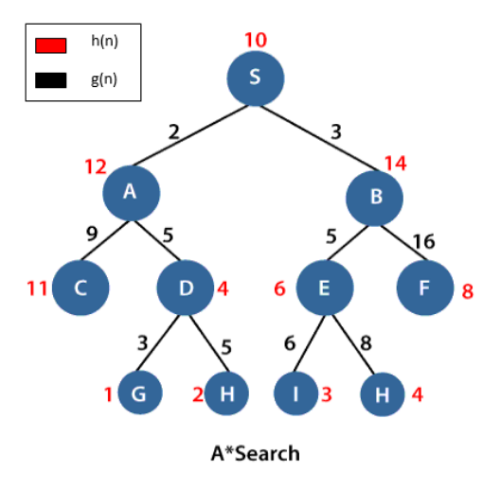
A* Search Algorithm
S is the root node, and G is the goal node. Starting from the root node S and moving towards its next successive nodes A and B. In order to reach the goal node G, calculate the f(n) value of node S, A and B using the evaluation equation i.e.
f(n)=g(n)+h(n)
Calculation of f(n) for node S:
f(S)=(distance from node S to S) + h(S)
0+10=10.
Calculation of f(n) for node A:
f(A)=(distance from node S to A)+h(A)
2+12=14
Calculation of f(n) for node B:
f(B)=(distance from node S to B)+h(B)
3+14=17
Therefore, node A has the lowest f(n) value. Hence, node A will be explored to its next level nodes C and D and again calculate the lowest f(n) value. After calculating, the sequence we get is S->A->D->G with f(n)=13(lowest value)

Slide 15
The performance measure of A* search
Completeness: The star(*) in A* search guarantees to reach the goal node.
Optimality: An underestimated cost will always give an optimal solution.
Space and time complexity: A* search has O(bd) space and time complexities.
Disadvantage of A* search
A* mostly runs out of space for a long period.

Slide 16
Constraint Satisfaction Problems
onstraint satisfaction is a technique where a problem is solved when its values satisfy certain constraints or rules of the problem. Such type of technique leads to a deeper understanding of the problem structure as well as its complexity.
Constraint satisfaction depends on three components, namely:
X: It is a set of variables.
D: It is a set of domains where the variables reside. There is a specific domain for each variable.
C: It is a set of constraints which are followed by the set of variables.
In constraint satisfaction, domains are the spaces where the variables reside, following the problem specific constraints. These are the three main elements of a constraint satisfaction technique. The constraint value consists of a pair of {scope, rel}. The scope is a tuple of variables which participate in the constraint and rel is a relation which includes a list of values which the variables can take to satisfy the constraints of the problem.

Slide 17
Solving Constraint Satisfaction Problems
The requirements to solve a constraint satisfaction problem (CSP) is:
A state-space
The notion of the solution.
A state in state-space is defined by assigning values to some or all variables such as
{X₁=v₁, X₂=v₂, and so on…}.
An assignment of values to a variable can be done in three ways:
Consistent or Legal Assignment: An assignment which does not violate any constraint or rule is called Consistent or legal assignment.
Complete Assignment: An assignment where every variable is assigned with a value, and the solution to the CSP remains consistent. Such assignment is known as Complete assignment.
Partial Assignment: An assignment which assigns values to some of the variables only. Such type of assignments are called Partial assignments.
Types of Domains in CSP
There are following two types of domains which are used by the variables :
Discrete Domain: It is an infinite domain which can have one state for multiple variables. For example, a start state can be allocated infinite times for each variable.
Finite Domain: It is a finite domain which can have continuous states describing one domain for one specific variable. It is also called a continuous domain.

Slide 19
REFERENCES
Artificial Intelligence: A Modern Approach by Stuart Russell and Peter Norvig. Prentice-Hall, 2003 (2nd Edition).

Slide 20
THANK YOU
For queries
Email: Ankur.e13693@cumail.in

